Slide 1
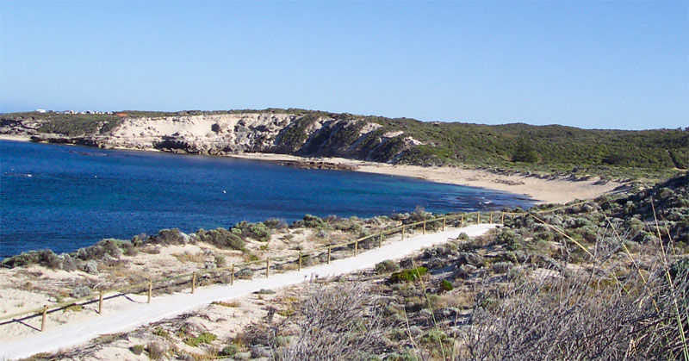
www.mathxtc.com

Slide 2
Objective: To make as much money as possible
over 14 days.
Start With: 2 plants (each plant cost $4500)
1 plant = 1 boat + 10 pots
Bank Loan: $9500 from the Corcoran Bank
(2 plants + $500 loan application fee)

Slide 3
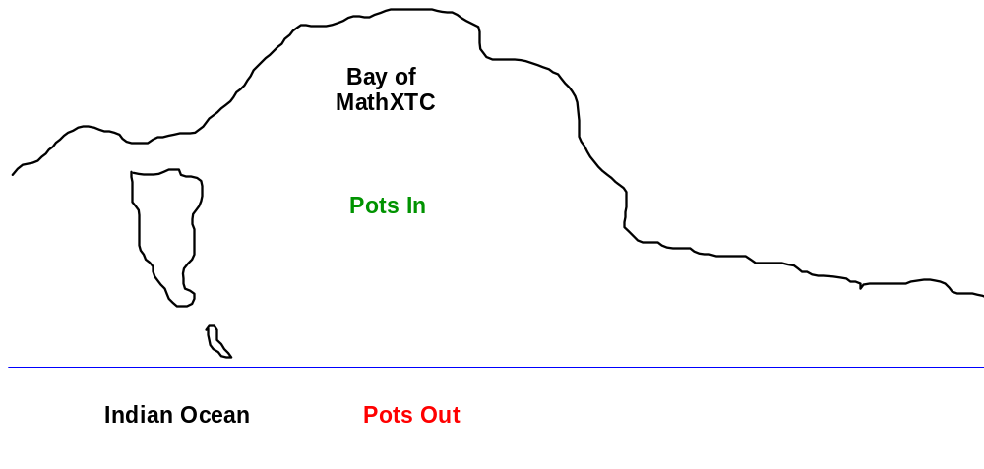
Good Weather: $60 / pot
Bad Weather: $20 / pot
Good Weather: $200 / pot
Bad Weather: $−50 / pot

Slide 4
1 | 2 | 3 | 4 | 5 | 6
Weather Die
Same as day before
Good Weather
Bad Weather

Slide 5
Corcoran Bank Conditions, Fees and Charges
  Minimum repayments of $500 per day.
  Interest on loan is charged at 11% per day
  calculated in advance.
  Application fee of $500 applies to any loan.
  Assets (plants and bank balance) must be
  used or sold to meet the repayments.
  All plants to be sold at the end of 14 days.
  Each plant sells for $3000.
  Total assets = plants + bank balance.

Slide 6
Day | Pots | In | Out | Weather | Working | Bank Payment | Plants Buy/Sell | Debt | Debt +11% | Credit Balance
1 | 20 |  |  |  |  |  |  | 9500
2

Slide 7
Day | Pots | In | Out | Weather | Working | Bank Payment | Plants Buy/Sell | Debt | Debt +11% | Credit Balance
1 | 20 |  |  |  |  |  |  | 9500
2
×1.11
=10545

Slide 8
Day | Pots | In | Out | Weather | Working | Bank Payment | Plants Buy/Sell | Debt | Debt +11% | Credit Balance
1 | 20 |  |  |  |  |  |  | 9500 | 10545
2
10
10
Good
10 × 60
+
10 × 200
= 2600

Slide 9
Day | Pots | In | Out | Weather | Working | Bank Payment | Plants Buy/Sell | Debt | Debt +11% | Credit Balance
1 | 20 | 10 | 10 | Good | 2600 |  |  | 9500 | 10545
2
1000
---
1600

Slide 10
Day | Pots | In | Out | Weather | Working | Bank Payment | Plants Buy/Sell | Debt | Debt +11% | Credit Balance
1 | 20 | 10 | 10 | Good | 2600 | 1000 | --- | 9500 | 10545 | 1600
2
−1000
9545
×1.11
=10595

Slide 11
Day | Pots | In | Out | Weather | Working | Bank Payment | Plants Buy/Sell | Debt | Debt +11% | Credit Balance
1 | 20 | 10 | 10 | Good | 2600 | 1000 | --- | 9500 | 10545 | 1600
2 | 20 |  |  |  |  |  |  | 9545 | 10595
5
15
Good
5 × 60
+
15 × 200
= 3300

Slide 12
Day | Pots | In | Out | Weather | Working | Bank Payment | Plants Buy/Sell | Debt | Debt +11% | Credit Balance
1 | 20 | 10 | 10 | Good | 2600 | 1000 | --- | 9500 | 10545 | 1600
2 | 20 | 5 | 15 | Good | 3300 |  |  | 9545 | 10595
3000
---
1900

Slide 13
Day | Pots | In | Out | Weather | Working | Bank Payment | Plants Buy/Sell | Debt | Debt +11% | Credit Balance
1 | 20 | 10 | 10 | Good | 2600 | 1000 | --- | 9500 | 10545 | 1600
2 | 20 | 5 | 15 | Good | 3300 | 3000 | --- | 9545 | 10595 | 1900
3 | 20
−3000
7595
×1.11
=8430

Slide 14
Day | Pots | In | Out | Weather | Working | Bank Payment | Plants Buy/Sell | Debt | Debt +11% | Credit Balance
1 | 20 | 10 | 10 | Good | 2600 | 1000 | --- | 9500 | 10545 | 1600
2 | 20 | 5 | 15 | Good | 3300 | 3000 | --- | 9545 | 10595 | 1900
3 | 20 |  |  |  |  |  |  | 7595 | 8430

Slide 15
